Slide 1

Lecture 5:
DC & Transient Response

Slide 2
Outline
Pass Transistors
DC Response
Logic Levels and Noise Margins
Transient Response
RC Delay Models
Delay Estimation
5: DC and Transient Response

Slide 3
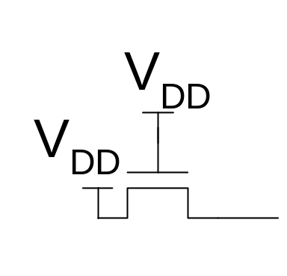
Pass Transistors
We have assumed source is grounded
What if source > 0?
  e.g. pass transistor passing V_{DD}
V_{g} = V_{DD}
  If V_{s} > V_{DD}-V_{t}, V_{gs} < V_{t}
  Hence transistor would turn itself off
nMOS pass transistors pull no higher than V_{DD}-V_{tn}
  Called a degraded “1”
  Approach degraded value slowly (low I_{ds})
pMOS pass transistors pull no lower than V_{tp}
Transmission gates are needed to pass both 0 and 1
5: DC and Transient Response

Slide 4
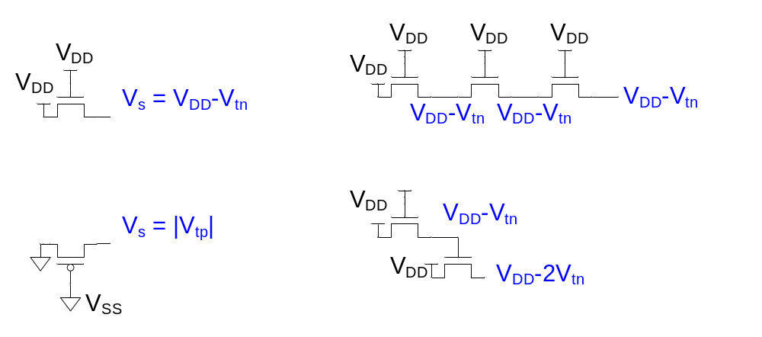
Pass Transistor Ckts
As the source can rise to within a threshold voltage of the gate, the output of several transistors in series is no more degraded than that of a single transistor
5: DC and Transient Response

Slide 5
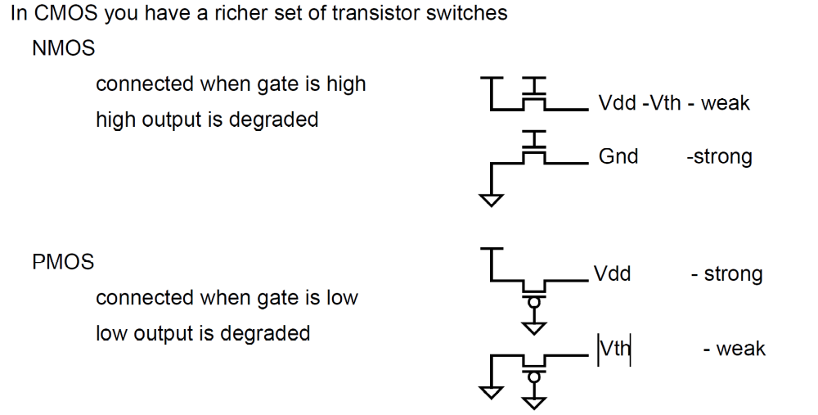
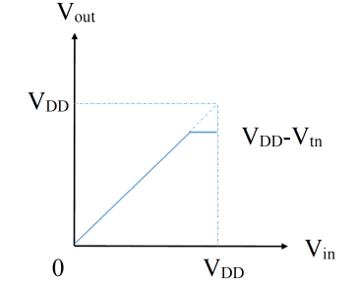
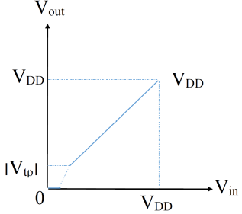
Pass Transistor Ckts
V_{DD}
V_{DD}
V_{DD}
V_{DD}
5: DC and Transient Response

Slide 6
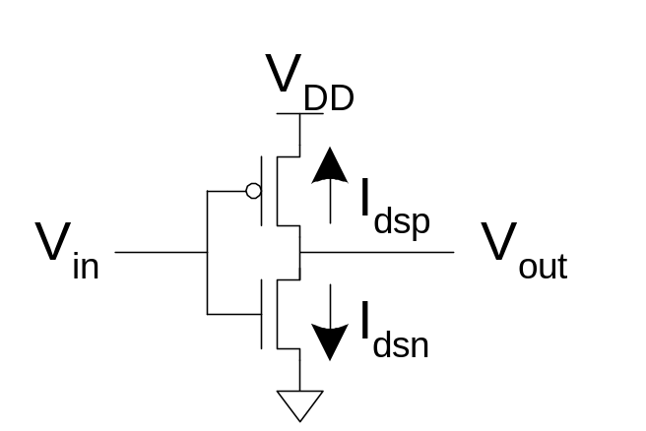
DC Response
DC Response: V_{out} vs. V_{in} for a gate
Ex: Inverter
  When V_{in} = 0 -> V_{out} = V_{DD}
  When V_{in} = V_{DD} -> V_{out} = 0
  In between, V_{out} depends on
  transistor size and current
  By KCL, must settle such that
  I_{dsn} = |I_{dsp}|
  We could solve equations
  But graphical solution gives more insight
5: DC and Transient Response
Notes:
Kirchhoff's current law (KCL) 基尔霍夫电流定律

Slide 7
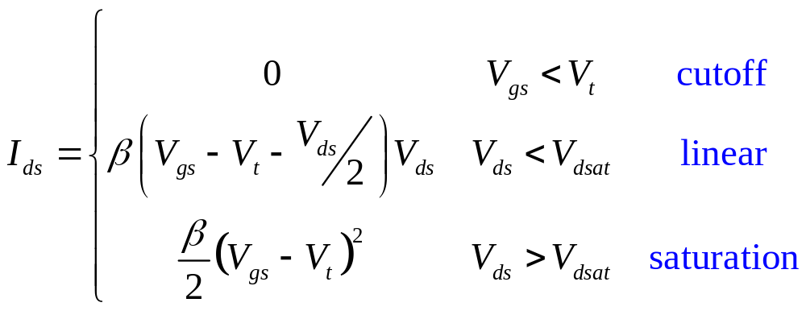
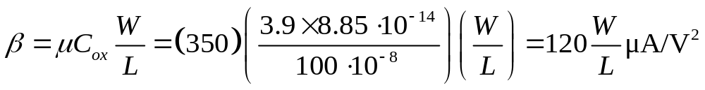
Transistor Operation
Current depends on region of transistor behavior
For what V_{in} and V_{out} are nMOS and pMOS in
  Cutoff?
  Linear?
  Saturation?
5: DC and Transient Response

Slide 8
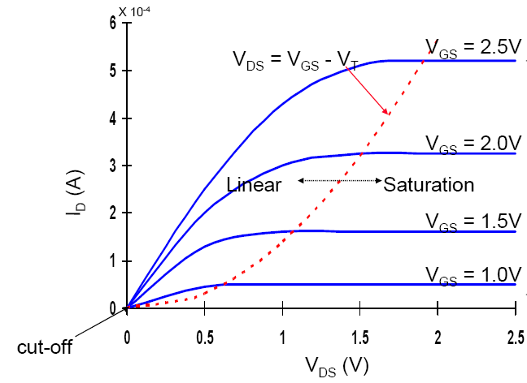
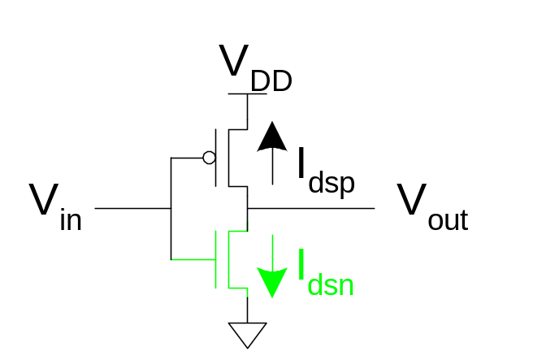
nMOS Operation
Cutoff | Linear | Saturated
V_{gsn} < V_{tn} V_{in} < V_{tn} | V_{gsn} > V_{tn} V_{in} > V_{tn} V_{dsn} < V_{gsn} – V_{tn} V_{out} < V_{in} - V_{tn} | V_{gsn} > V_{tn} V_{in} > V_{tn} V_{dsn} > V_{gsn} – V_{tn} V_{out} > V_{in} - V_{tn}
V_{gsn} = V_{in}
V_{dsn} = V_{out}
5: DC and Transient Response

Slide 9
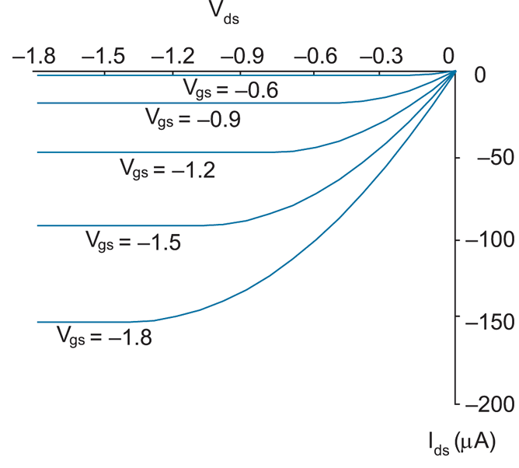
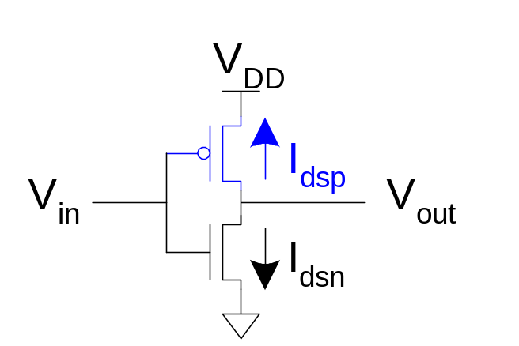
pMOS Operation
Cutoff | Linear | Saturated
V_{gsp} > V_{tp} V_{in} > V_{DD} + V_{tp} | V_{gsp} < V_{tp} V_{in} < V_{DD} + V_{tp} V_{dsp} > V_{gsp} – V_{tp} V_{out} > V_{in} - V_{tp} | V_{gsp} < V_{tp} V_{in} < V_{DD} + V_{tp} V_{dsp} < V_{gsp} – V_{tp} V_{out} < V_{in} - V_{tp}
V_{tp} < 0
V_{gsp} = V_{in} - V_{DD}
V_{dsp} = V_{out} - V_{DD}
V_{gsp} – V_{tp}
5: DC and Transient Response

Slide 10
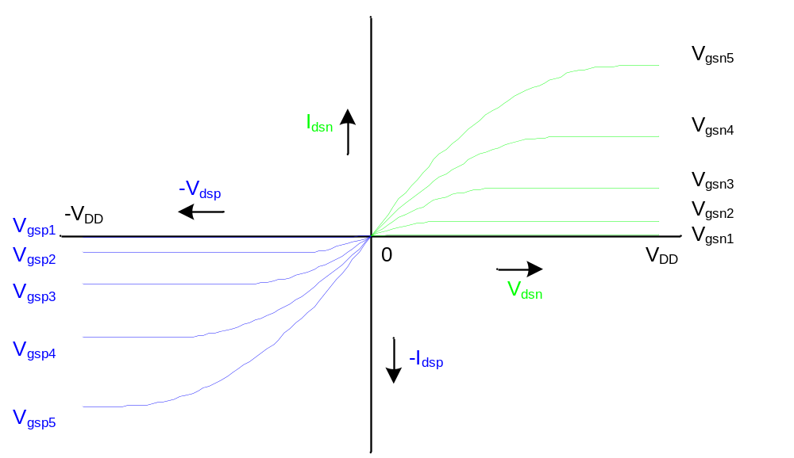
I-V Characteristics
Make pMOS is wider than nMOS such that β_{n} = β_{p}
5: DC and Transient Response

Slide 11
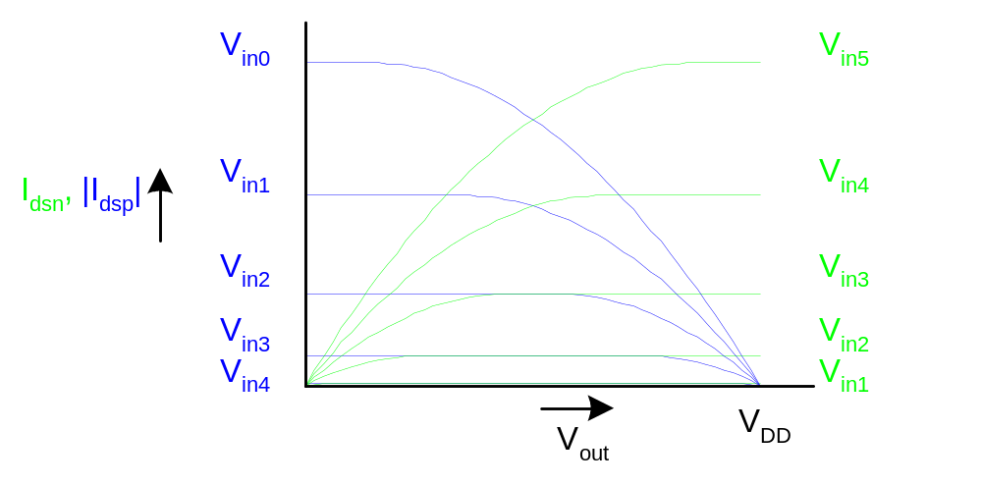
Current vs. V_{out}, V_{in}
V_{gsp} = V_{in} - V_{DD}
5: DC and Transient Response

Slide 12
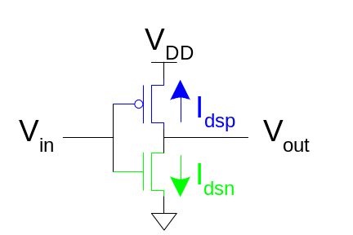
Load Line Analysis
For a given V_{in}:
  Plot I_{dsn}, I_{dsp} vs. V_{out}
  V_{out} must be where |currents| are equal in
5: DC and Transient Response

Slide 13
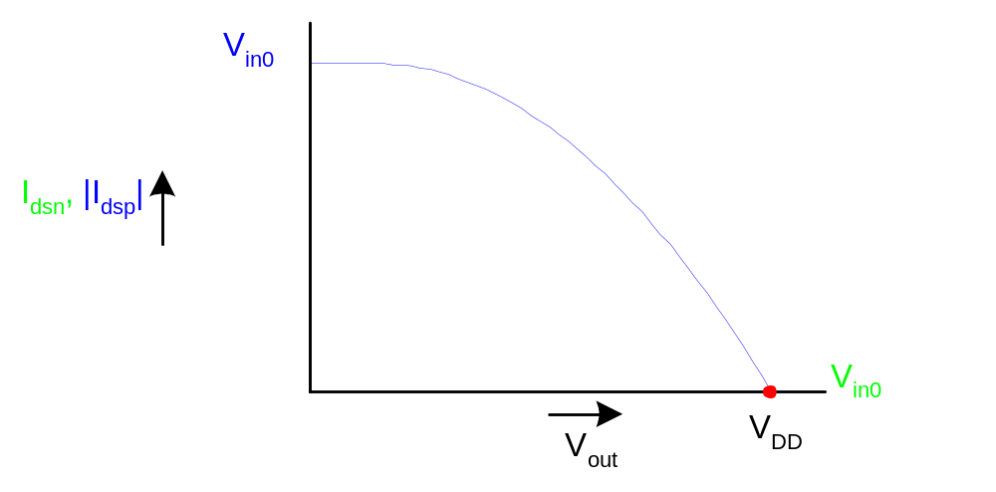
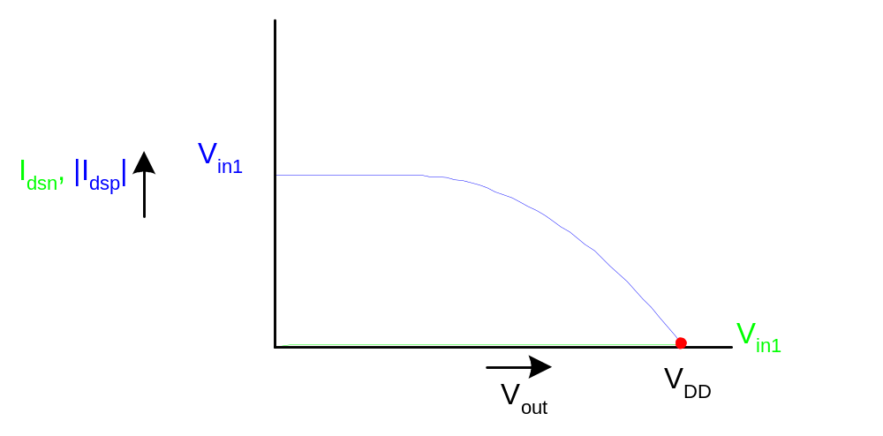
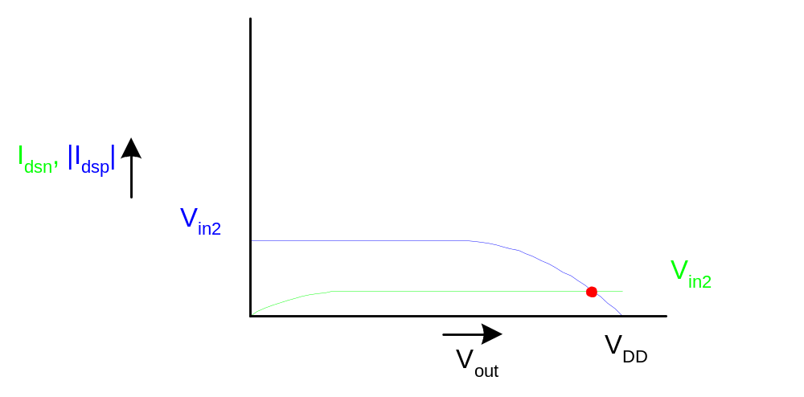
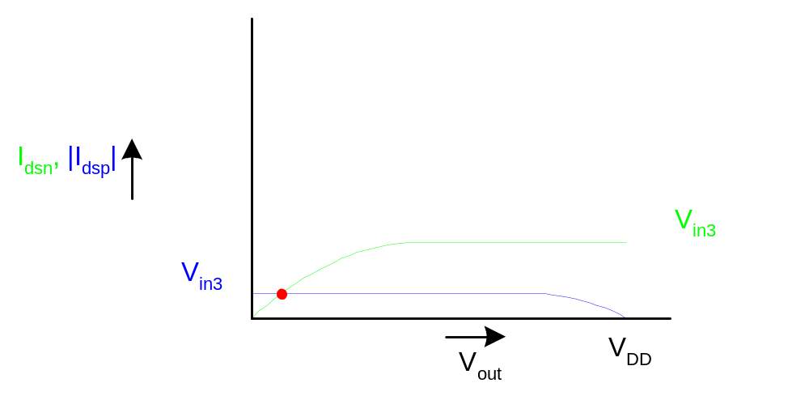
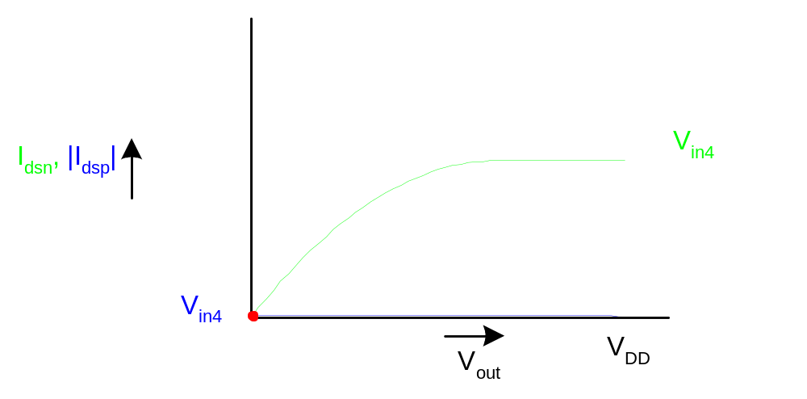
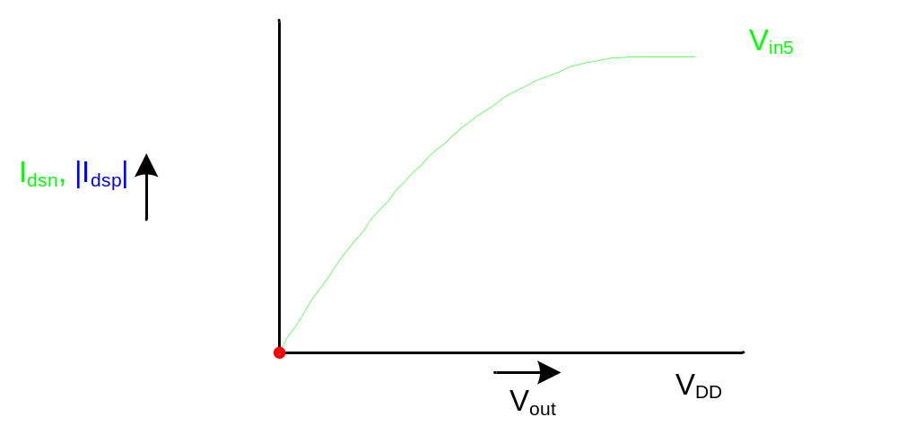
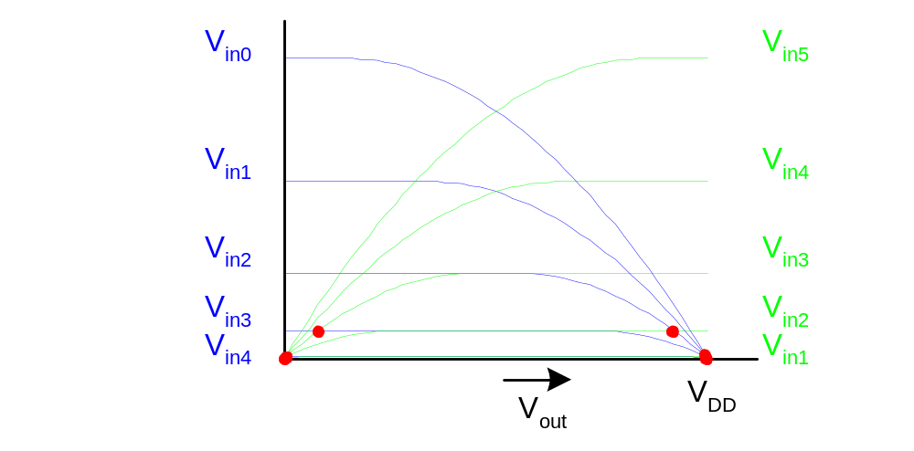
Load Line Analysis
V_{in} = 0
V_{in} = 0
0.2V_{DD}
V_{DD}
0.4V_{DD}
0.6V_{DD}
0.8V_{DD}
5: DC and Transient Response

Slide 14
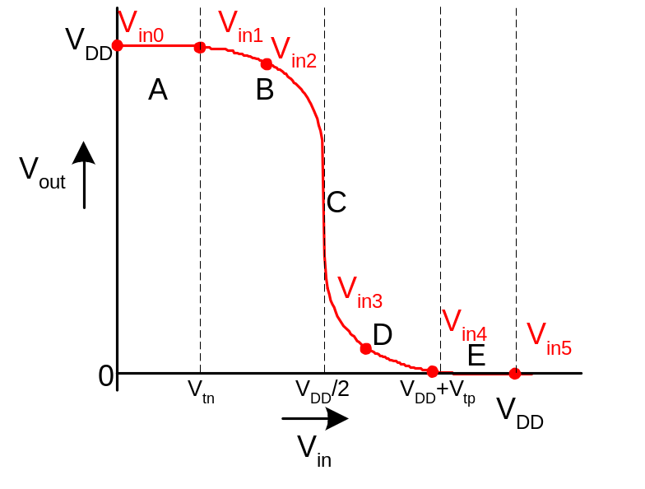
DC Transfer Curve
Transcribe points onto V_{in} vs. V_{out} plot
5: DC and Transient Response

Slide 15
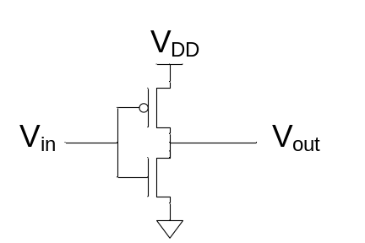
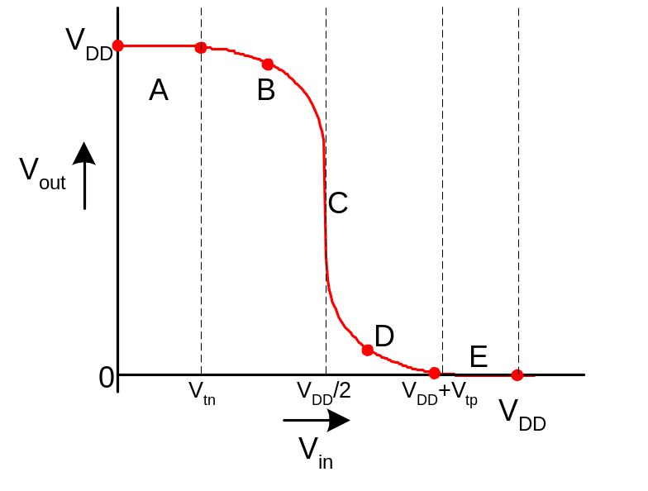
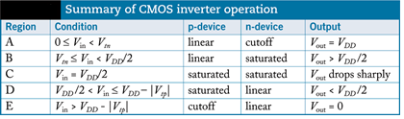
Operating Regions
Revisit transistor operating regions
Region | nMOS | pMOS
A | Cutoff | Linear
B | Saturation | Linear
C | Saturation | Saturation
D | Linear | Saturation
E | Linear | Cutoff
5: DC and Transient Response

Slide 16
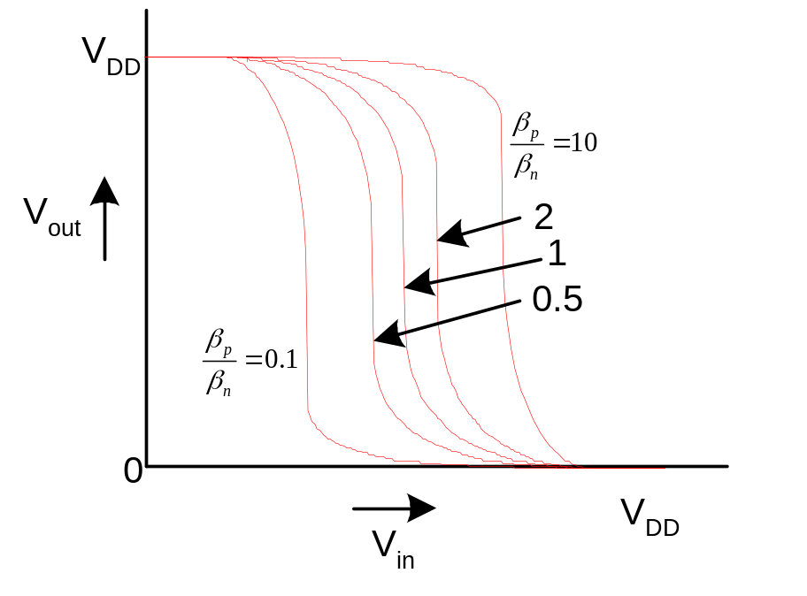
Beta Ratio
If β_{p} / β_{n} ≠ 1, switching point will move from V_{DD}/2
Called skewed gate
Other gates: collapse into equivalent inverter
5: DC and Transient Response

Slide 17
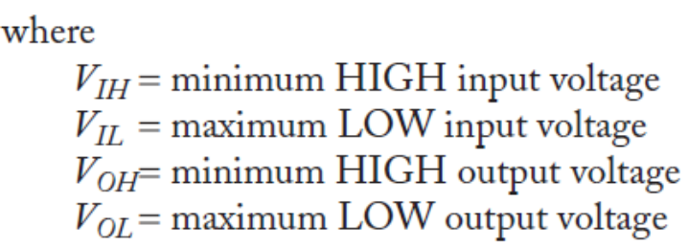
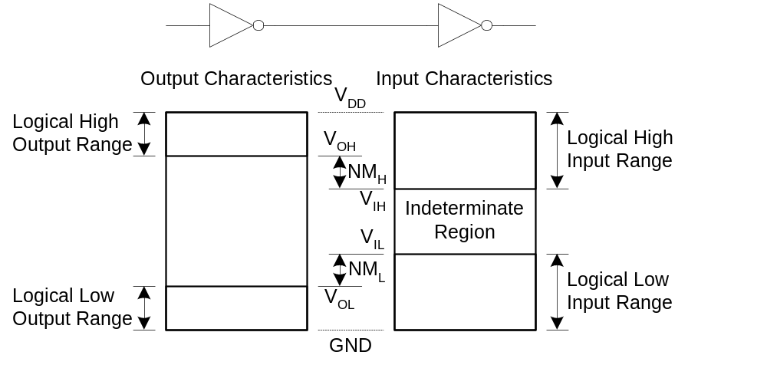
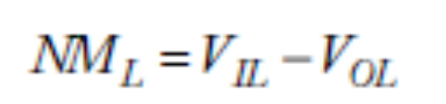
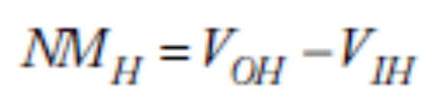
Noise Margins
How much noise can a gate input see before it does not recognize the input?
NM_{H}: High noise margin
NM_{L}: Low noise margin
5: DC and Transient Response

Slide 18
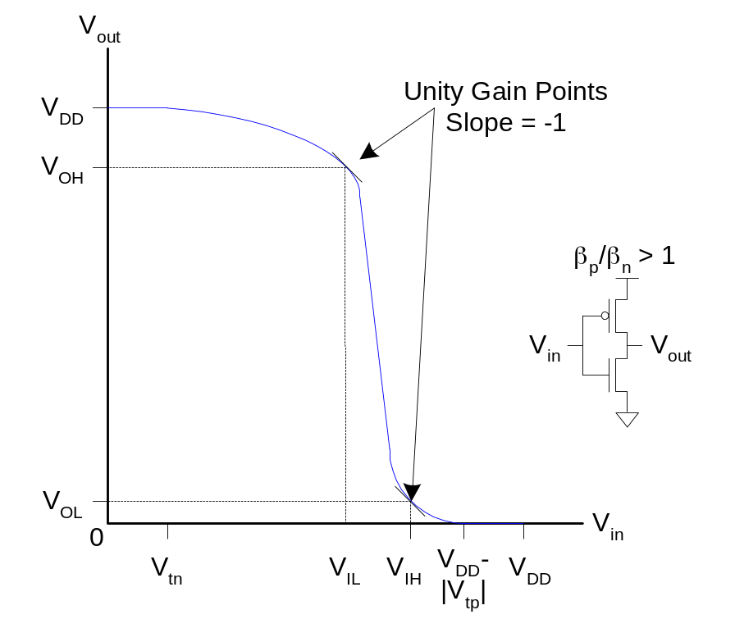
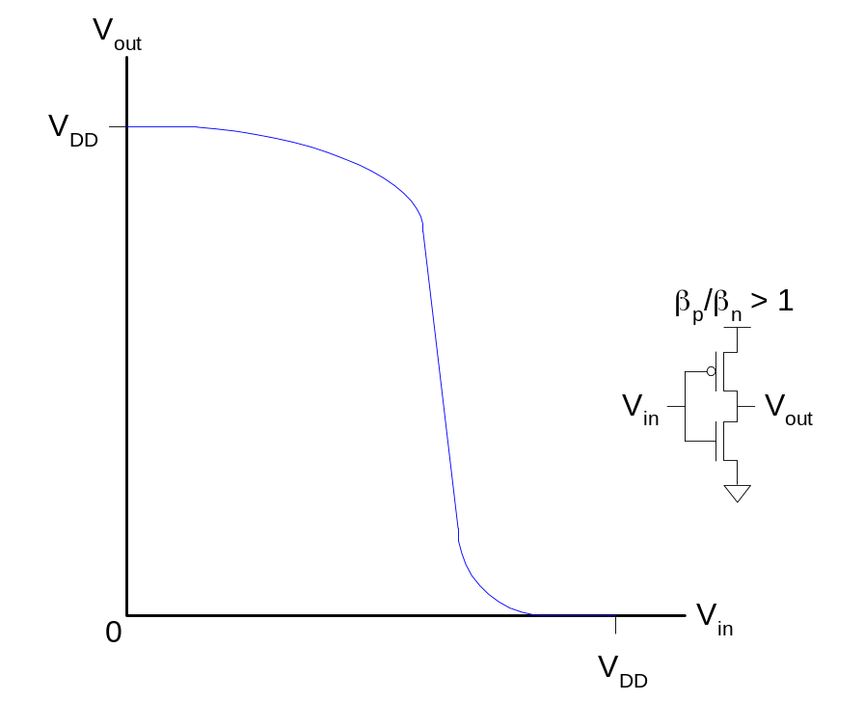
Logic Levels
To maximize noise margins, select logic levels at
  unity gain point of DC transfer characteristic
5: DC and Transient Response

Slide 19
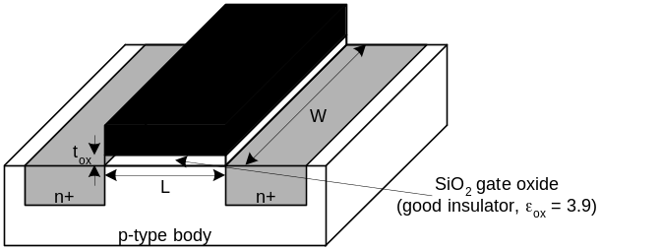

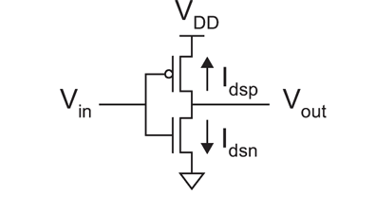
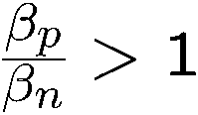
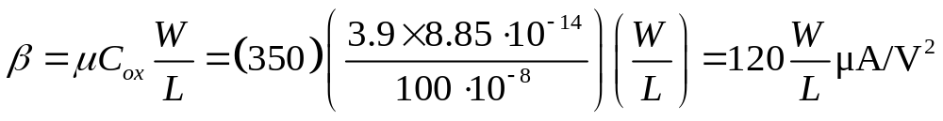

What is the impact of altering the PMOS width in comparison to the NMOS width on the DC char?
I
dsn
,
|
I
dsp
|
V
in3
V
V
in3
in3
V
in3
V
V
DD
out
If we increase (decrease) the width of PMOS compared to NMOS
→ for the same input voltage, a higher (lower) output voltage is obtained
V
out
V
in

Slide 20
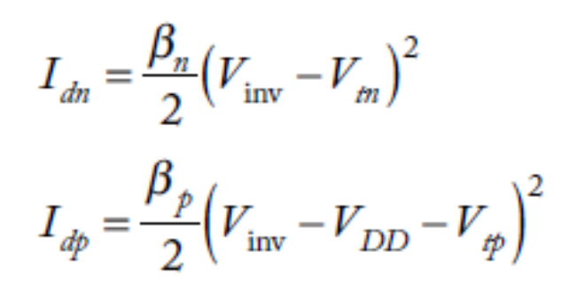
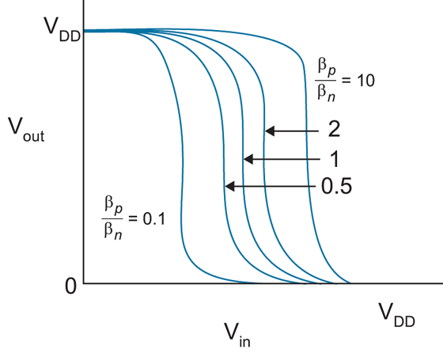
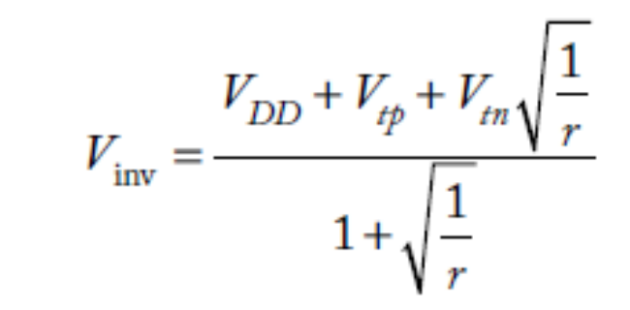

Impact of skewing transistor sizes on inverter noise margins
Increasing (decreasing) PMOS width to NMOS width increases (decreases) the low noise margin and decreases (increases) the high noise margin
5: DC and Transient Response
Notes:
VDD=1.V Vth=0.3; r=2, Vinv=0.53V; r=10, Vinv=0.60V

Slide 21
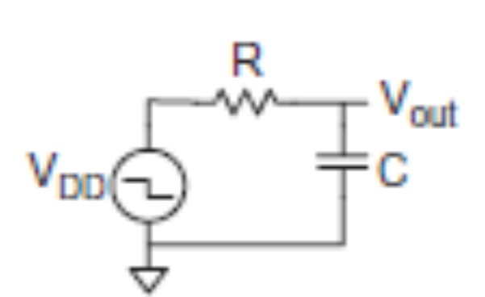
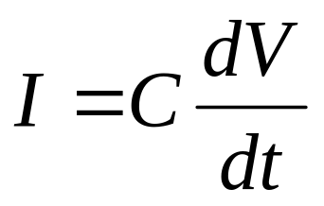
Transient Response
DC analysis tells us V_{out} if V_{in} is constant
Transient analysis tells us V_{out}(t) if V_{in}(t) changes
  Requires solving differential equations
Input is usually considered to be a step or ramp
  From 0 to V_{DD} or vice versa
5: DC and Transient Response

Slide 22
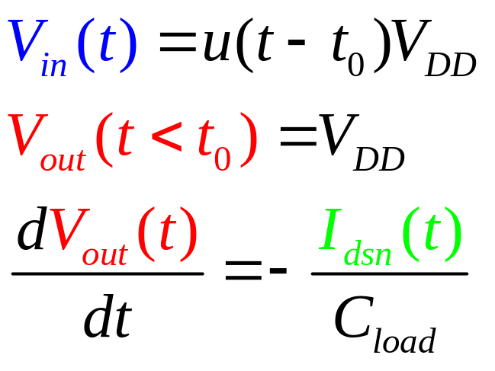
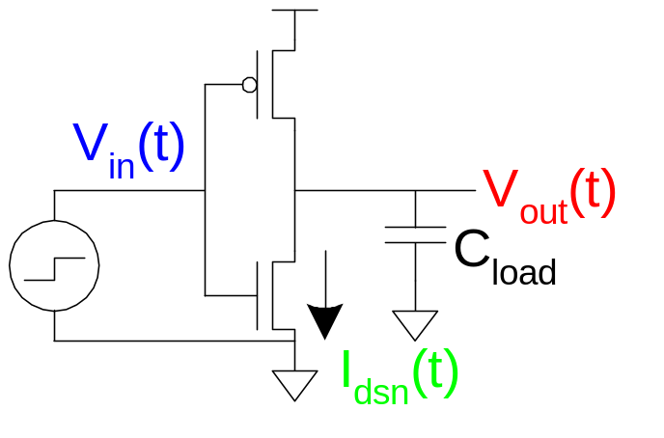
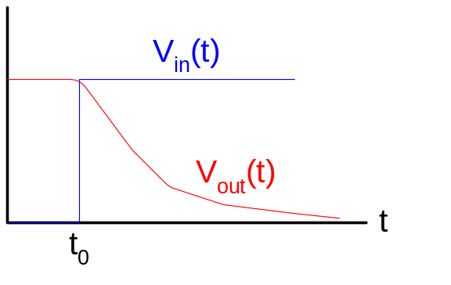
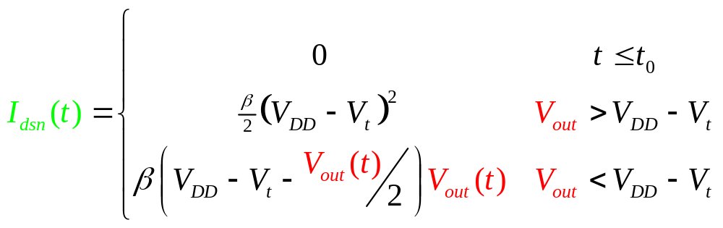
Inverter Step Response
Ex: find step response of inverter driving load cap
5: DC and Transient Response

Slide 23
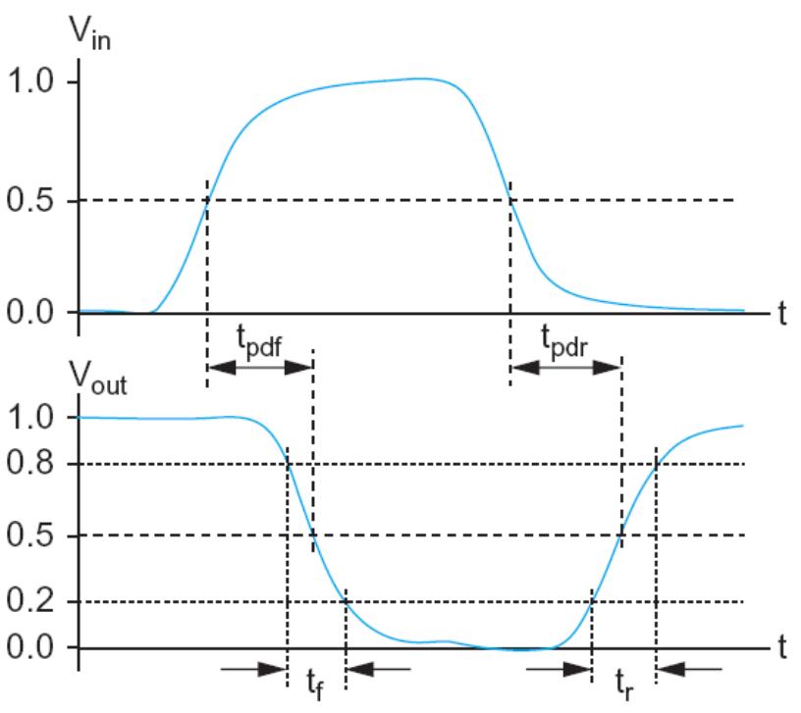
Delay Definitions
t_{pdr}: rising propagation delay
  From input to rising output crossing V_{DD}/2
t_{pdf}: falling propagation delay
  From input to falling output crossing V_{DD}/2
t_{pd}: average propagation delay
  t_{pd} = (t_{pdr} + t_{pdf})/2
t_{r}: rise time
  From output crossing 0.2 V_{DD} to 0.8 V_{DD}
t_{f}: fall time
  From output crossing 0.8 V_{DD} to 0.2 V_{DD}
5: DC and Transient Response

Slide 24
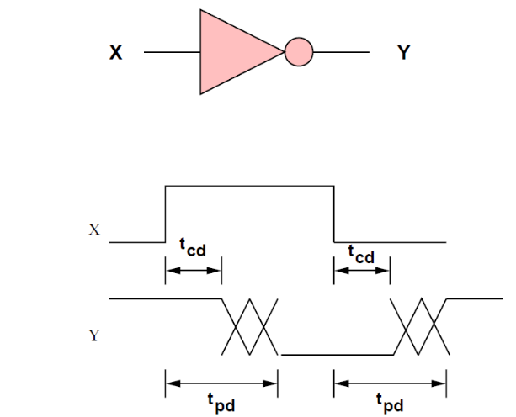
Delay Definitions
t_{cdr}: rising contamination delay
  From input to rising output crossing V_{DD}/2
t_{cdf}: falling contamination delay
  From input to falling output crossing V_{DD}/2
t_{cd}: average contamination delay
  t_{pd} = (t_{cdr} + t_{cdf})/2
When input changes the output maintains its old value for a duration called the contamination time
max-time and min-time
5: DC and Transient Response
Notes:
When input changes the output maintains its old value for a duration called the contamination time

Slide 25
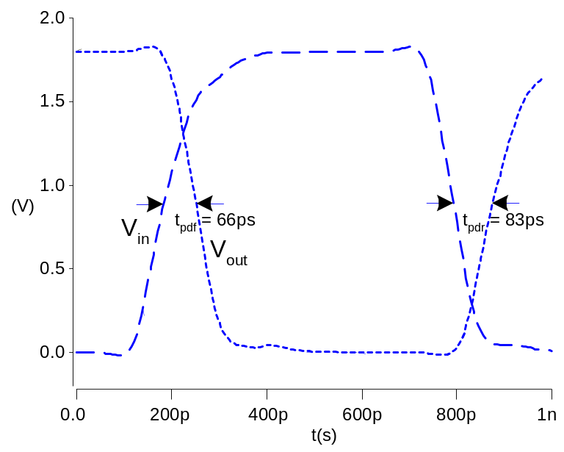
Simulated Inverter Delay
Solving differential equations by hand is too hard
SPICE simulator solves the equations numerically
  Uses more accurate I-V models too!
But simulations take time to write, may hide insight
5: DC and Transient Response

Slide 26
Delay Estimation
We would like to be able to easily estimate delay
  Not as accurate as simulation
  But easier to ask “What if?”
The step response usually looks like a 1st order RC response with a decaying exponential.
Use RC delay models to estimate delay
  C = total capacitance on output node
  Use effective resistance R
  So that t_{pd} = RC
Characterize transistors by finding their effective R
  Depends on average current as gate switches
5: DC and Transient Response

Slide 27
Effective Resistance
Shockley models have limited value
  Not accurate enough for modern transistors
  Too complicated for much hand analysis
Simplification: treat transistor as resistor
  Replace I_{ds}(V_{ds}, V_{gs}) with effective resistance R
    I_{ds} = V_{ds}/R
  R averaged across switching of digital gate
Too inaccurate to predict current at any given time
  But good enough to predict RC delay
5: DC and Transient Response

Slide 28
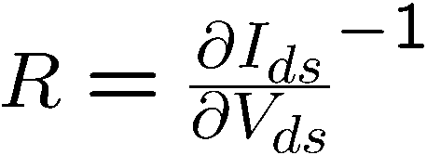


Transistor resistance
In the linear region
Not accurate, but at least shows that the resistance is proportional to L/W and decreases with V_{gs}
If R/C are for a unit size transistor then a transistor of K unit width has KC capacitance and R/K resistance
The resistance of a PMOS transistor = 2× resistance of NMOS transistor of the same size
5: DC and Transient Response

Slide 29

RC Delay Model
Use equivalent circuits for MOS transistors
  Ideal switch + capacitance and ON resistance
  Unit nMOS has resistance R, capacitance C
  Unit pMOS has resistance 2R, capacitance C
Capacitance proportional to width
Resistance inversely proportional to width
5: DC and Transient Response

Slide 30
RC Values
Capacitance
  C = C_{g} = C_{s} = C_{d} = 2 fF/μm of gate width in 0.6 μm
  Gradually decline to 1 fF/μm in 65 nm
Resistance
  R ≈ 10 KΩ•μm in 0.6 μm process
  Improves with shorter channel lengths
  1.25 KΩ•μm in 65 nm process
Unit transistors
  May refer to minimum contacted device (4/2 λ)
  Or maybe 1 μm wide device
  Doesn’t matter as long as you are consistent
5: DC and Transient Response

Slide 31

Inverter Delay Estimate
Estimate the delay of a fanout-of-1 inverter
If the input A rises, the nMOS transistor will be ON and the pMOS OFF
d = 6RC
5: DC and Transient Response

Slide 32






Transient Response(I)
5: DC and Transient Response

Slide 33


Transient Response(II)
5: DC and Transient Response

Slide 34

Delay Model Comparison
C_{load} = 20 fF
VDD = 1.0 V
Vt = 0.3 V,
tox = 10.5 Ǻ
µ = 80 cm²/V · s
5: DC and Transient Response

Slide 35

Example: 3-input NAND
Sketch a 3-input NAND with transistor widths chosen to achieve effective rise and fall resistances equal to a unit inverter (R).
2
2
2
3
3
3
5: DC and Transient Response

Slide 36



3-input NAND Caps
Annotate the 3-input NAND gate with gate and diffusion capacitance.
5: DC and Transient Response

Slide 37


Elmore Delay
ON transistors look like resistors
Pullup or pulldown network modeled as RC ladder
Elmore delay of RC ladder
5: DC and Transient Response

Slide 38






Example: 3-input NAND
Estimate worst-case rising and falling delay of 3-input NAND driving h identical gates.
Rising
Falling
5: DC and Transient Response

Slide 39
Delay Components
Delay has two parts
  Parasitic delay
    9 or 12 RC
    Independent of load
  Effort delay
    5h RC
    Proportional to load capacitance
5: DC and Transient Response

Slide 40




Contamination Delay
Best-case (contamination) delay can be substantially less than propagation delay.
Ex: If all three inputs fall simultaneously
Falling
Rising
5: DC and Transient Response

Slide 41

Diffusion Capacitance
We assumed contacted diffusion on every s / d.
Good layout minimizes diffusion area
Ex: NAND3 layout shares one diffusion contact
  Reduces output capacitance by 2C
  Merged uncontacted diffusion might help too
5: DC and Transient Response

Slide 42

Layout Comparison
Which layout is better?
5: DC and Transient Response

